Slide 1
Mitigation Practices for low-carbon Livestock in sub-Saharan Africa research network-Living Lab
International Research Symposium on Agricultural Greenhouse Gas Mitigation. Berlin, Germany. (21 – 23 October, 2024)
Tobi Akinropo¹, Josias-Steve Adjassin¹, Habibou Assouma², Claudia Arndt³, J.A Odedire⁴, Alassan Seidou Assani⁵, Ali R. Bayat⁶, Cécile Martin¹, Diego Morgavi¹, Maguy Eugène^{1*}
Notes:
Transforming Food and Agricultural Systems through Research in Partnership with Africa

Slide 2
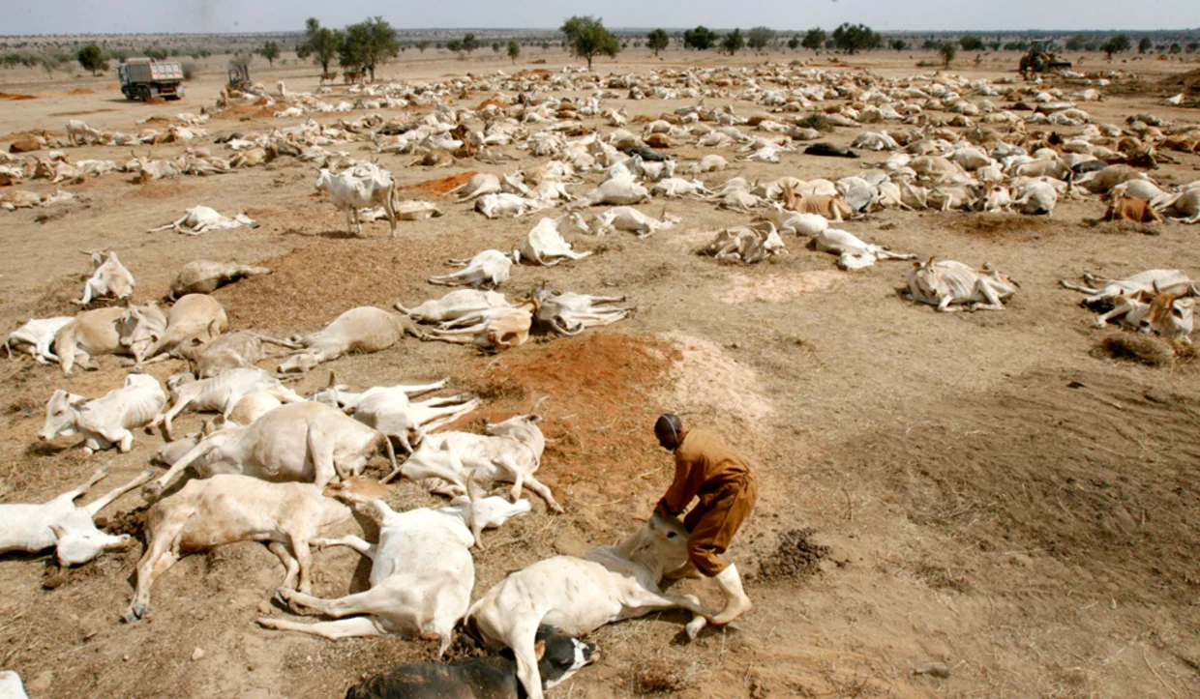
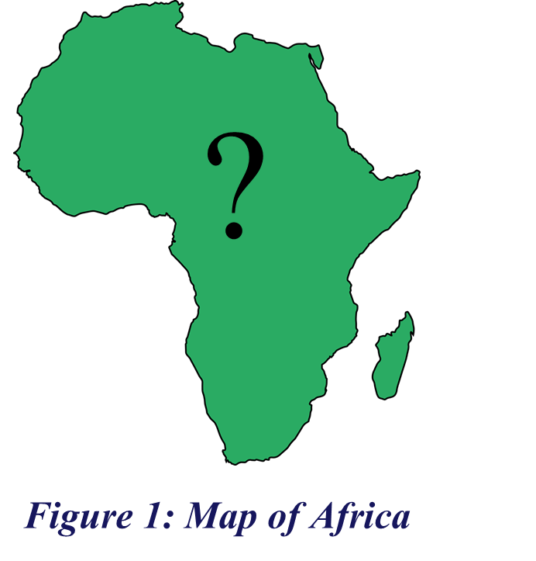
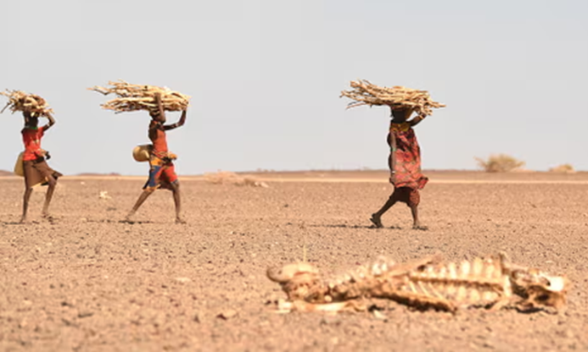
Introduction (1/2)
54 countries
Population: 1.216 billion
Land Area: 30.37 million km²
Livestock contributes about 35% of agricultural GDP in sub-Saharan Africa (SSA) (FAO, 2021)
SSA is characterized by high methane intensity reported from the estimate based on IPCC Tier 1
SSA is significantly affected by impacts of climate change
Notes:
Livestock are an important source of livelihoods in agricultural systems in sub-Saharan Africa (SSA), while also being the largest source of national greenhouse gas (GHG) emissions in most African countries
climate change magnifies socio-economic and environmental stresses in Sub-Saharan Africa,
In situ measurements of the environmental impact of livestock systems are limited in SSA . Overestimation of Enteric methane was reported by Graham et al 2022 for Cattle and under estimation for Small ruminant.

Slide 3
Research Questions
What are the research gaps in GHG quantification from livestock in SSA?
What best management practices (BMP) are used to increase livestock productivity?
Who are considered key actors in the research and innovation processes on GHG in SSA?
What are the low-carbon livestock mitigation practices in SSA?
Identification of potential training needs for GHG measurement and prediction methods
Notes:
Limited Context-Specific Emission Factors, Lack of Comprehensive Data on Livestock Management: Inadequate Research on Enteric Methane Mitigation Strategies
Improved Nutrition and Feeding Strategies; Genetic Selection and Breeding; Animal Health and Disease Control; Enhanced Reproductive Management; Sustainable Grazing and Pasture Management; Water Management; Housing and Environmental Control; Record Keeping and Data Management; Manure Management
National Governments and Policy Makers: International Research Institutions and Networks: Academic and Research Institutions: Non-Governmental Organizations (NGOs); Private Sector: Development Partners and International Donors
Improved Feeding Strategies: Improved Manure Management: Grazing Management; Breeding and Genetic Improvement: Integrating Crop-Livestock Systems: Conservation Agriculture
Measurement Techniques, Data Collection and Management: Modeling and Prediction Methods: Uncertainty Analysis: Policy Integration and Communication: Local Context Consideration

Slide 4
Materials & Methods (1/ 2)
On-going research on GHG quantification
WP2: Collaborative Research and Development
Farmers + Communities
T2: Baseline information in GHG in SSA (BMP)
T1&2 : Results on GHG from the pilots to the Living lab
T3: Pilot Results as Publications and Communique
Companies + NGOs, + Govt
T1&3: Draft of Living lab operations and methodolgy
WP1: Engagement and aggregation of baseline data in SSA
MeCLAN
(Researchers and Institutions)
WP3: Knowledge dissemination, Impact Assessment, and Future Planning
Figure 3: Flow chart of work packages
Notes:
Living labs are defined as user centered, open innovation ecesystem based on systemic user co-creation approach, intergrating research and innovation processes in real life communities and settings. Learning processes take place at the individual and community level.
WP1 : Creation of the LL

Slide 5
Materials & Methods (2/2)
Summary of the LL methodology
Transdisciplinary Approach
Experimentation
Laboratory analyses
Stakeholder engagement
Living laboratory
Focus group discussion
Training/ Visitation
Adoption rate evaluation
Livelihood economics
Pilot farm demonstration
Data mining
Web-based application
Life Sciences
Technology
Socio – economics
5

Slide 6
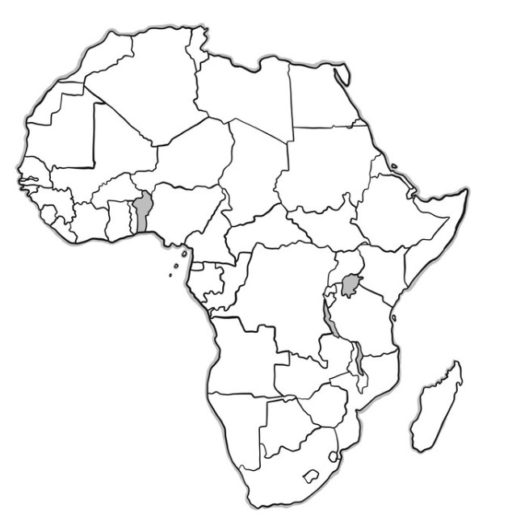
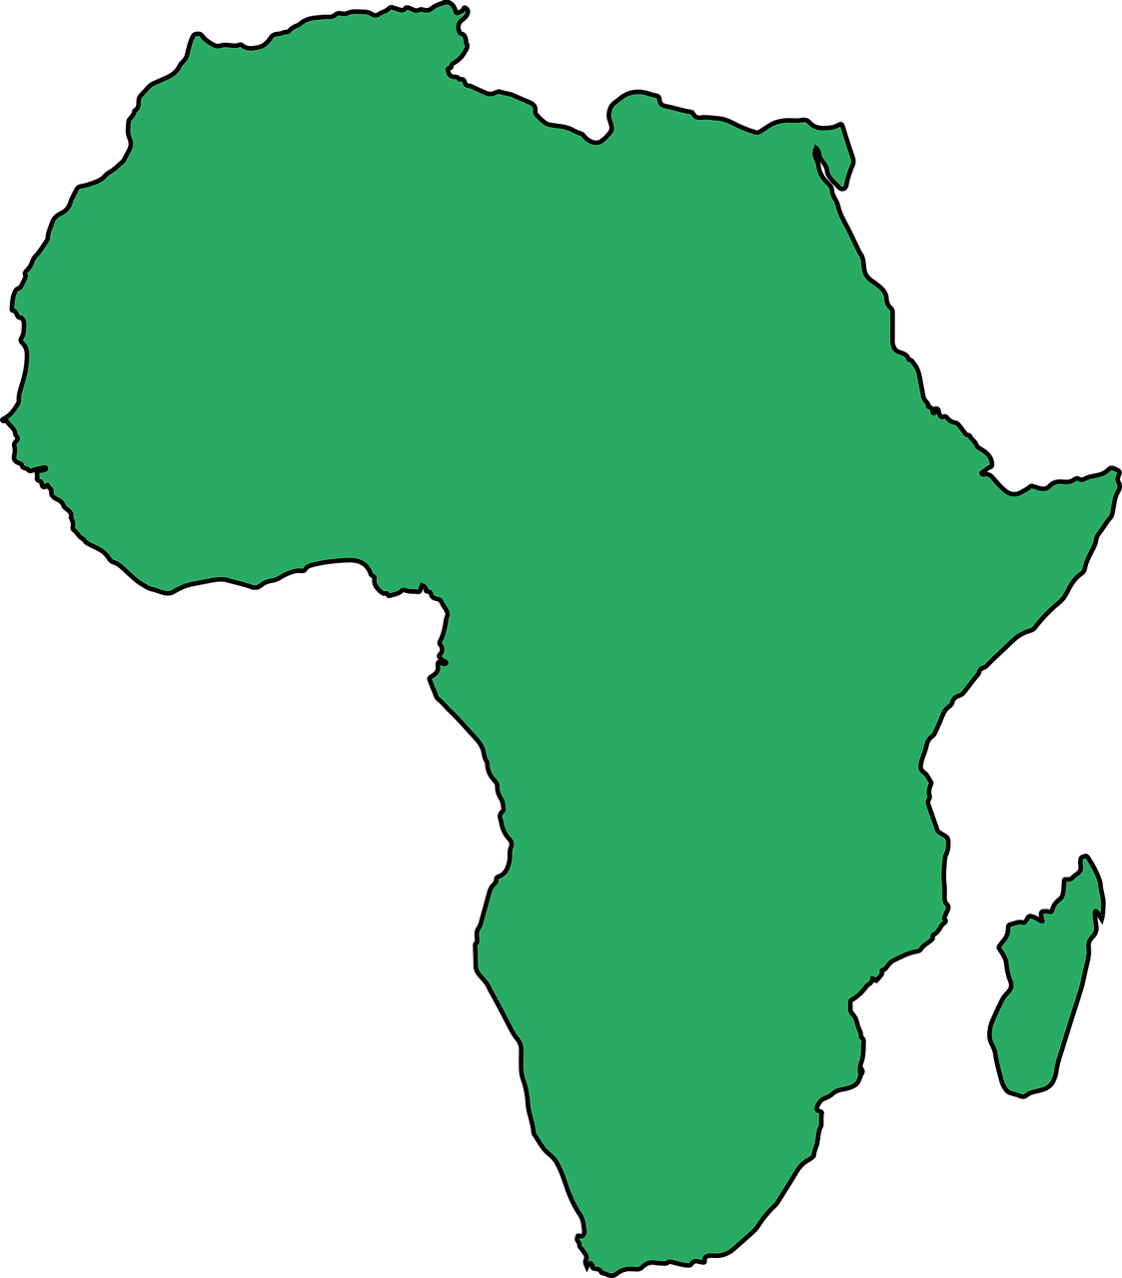
Results and Discussion (1/4)
Figure 4 : Identify facilities for enteric methane quantification in Africa
INRAE, France
CIRAD
Luke, Finland
IFAD
16 Organisations in the MeCLAN-MIPCLAN Consortium
Six countries with facilities for GHG quantification
Farmers, Govts, NGOs, private sector, Academia & International Organisations are key actors in R&D in GHG within SSA
MIPCLAN
BF – 2 Green feed (Cattle & SR); 1 laser methane detector
BJ – 2 Green feed (Cattle)
ET - 1 Green feed for cattle, 1 Handheld methane laser
KE – Respiratory chambers; SF6
TZ – Handheld methane laser
ZA – 1 respiratory Chambers, 4 GreenFeed, Handheld methane laser
BF
BJ
ET
KE
?
TZ
ZA
6
Notes:
Through Meclan, different facilities in Six countries were identified with contact of reserachers handling these facilities
Food and Agriculture Organization (FAO), Italy , Institut national de recherche pour l'agriculture, l'alimentation et l'environnement (INRAE), France; Centre de coopération internationale en recherche agronomique pour le développement (CIRAD), France; International Livestock Resaerch Iinstitute (ILRI), Kenya; University of Pretoria, South Africa; Institute of Rural Economy, Mali; Institute of Environment and Agricultural Research (INERA), Burkina Faso; Université d’Abomey-Calavi (UAC), Benin ; Institut Sénégalais de Recherches Agricoles (ISRA), Sénegal, Université d’Antananarivo , Madagascar; Institut de Recherche en Elevage pour le Développement, Tchad and National Center for Applied Research in Rural Development (FOFIFA), Madagascar. This was extended to sixteen (16) with the addition of other identified organizations (Obafemi Awolowo University, Nigeria; University of Parakou Benin; Natural Resources Institute Finland (LUKE), and International fund for Agriculture development (IFAD) Italy )
In red are facilities countries with available facilities

Slide 7
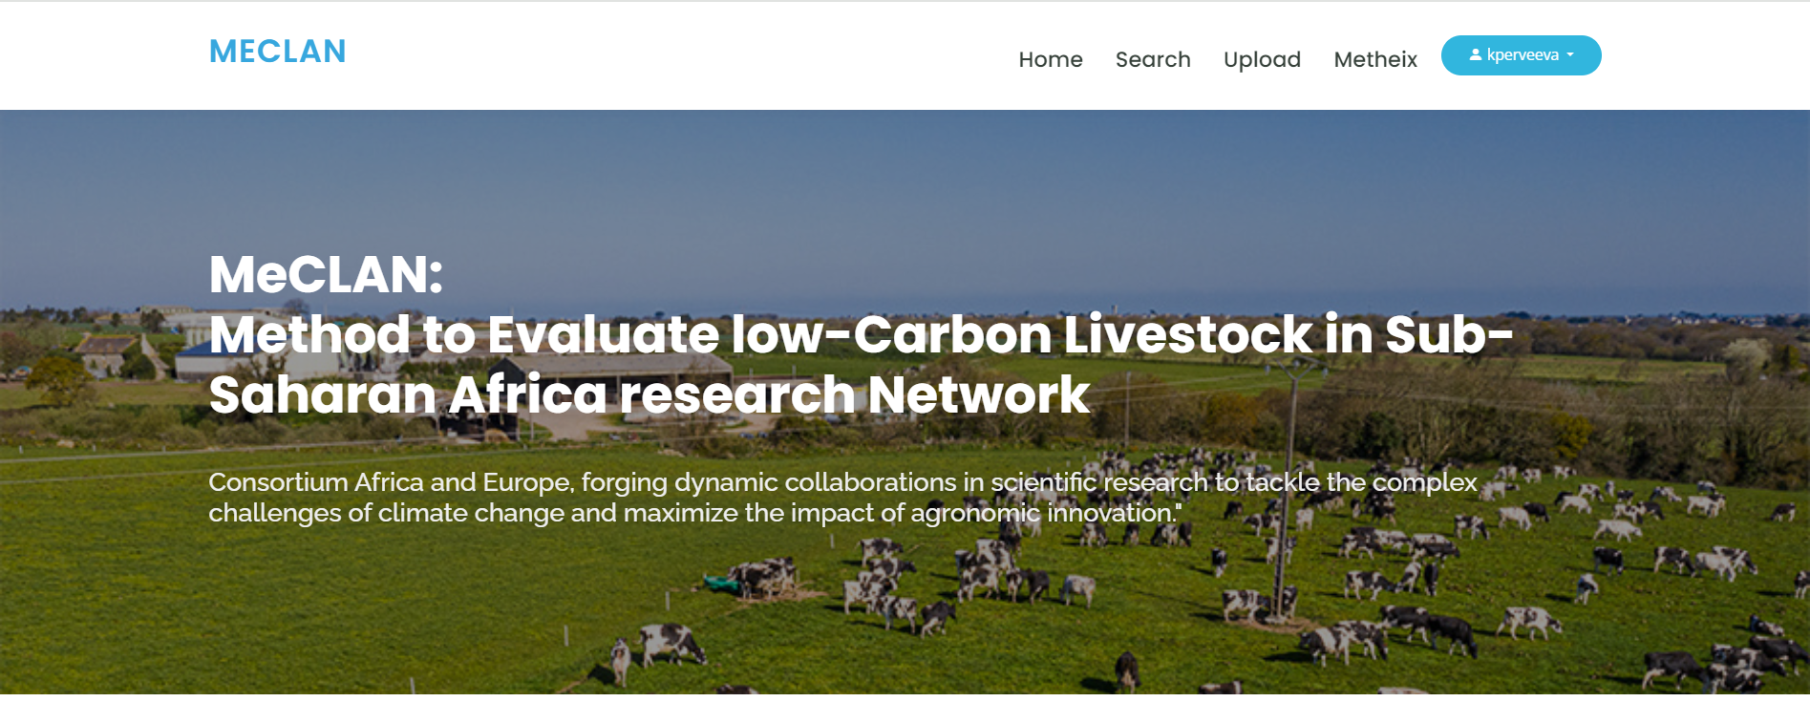
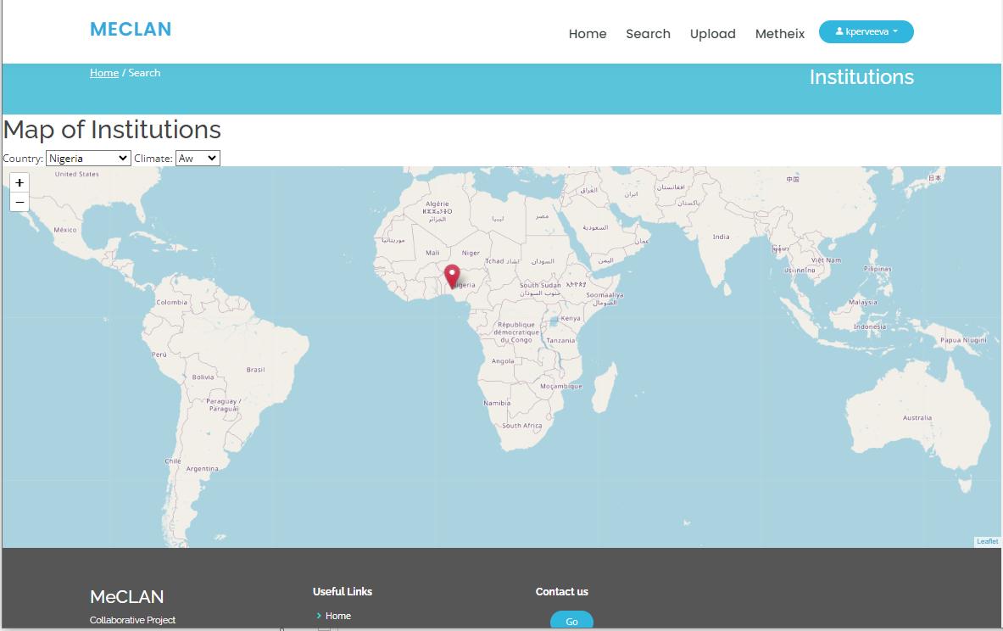
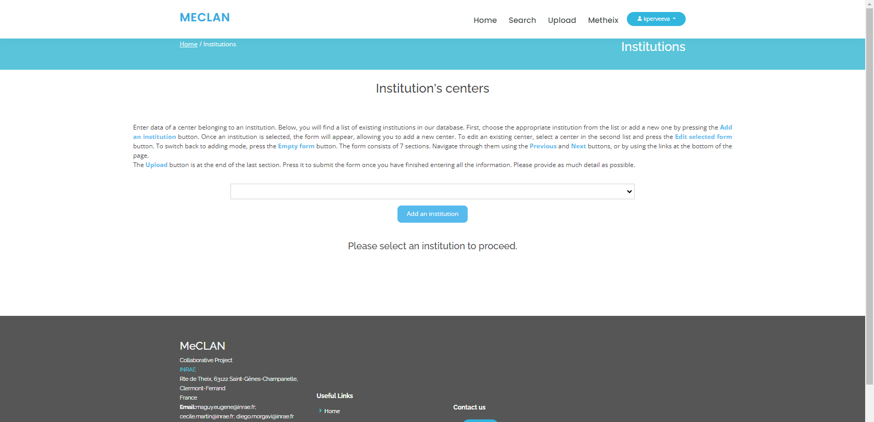
Results and Discussion (2/4)
Slides from the MeCLAN website
Information on centres, avaliable facilities and researchers
Interactive map system for easy assess
Linked to Metheix, which houses global enteric CH₄ database from ruminant

Slide 8
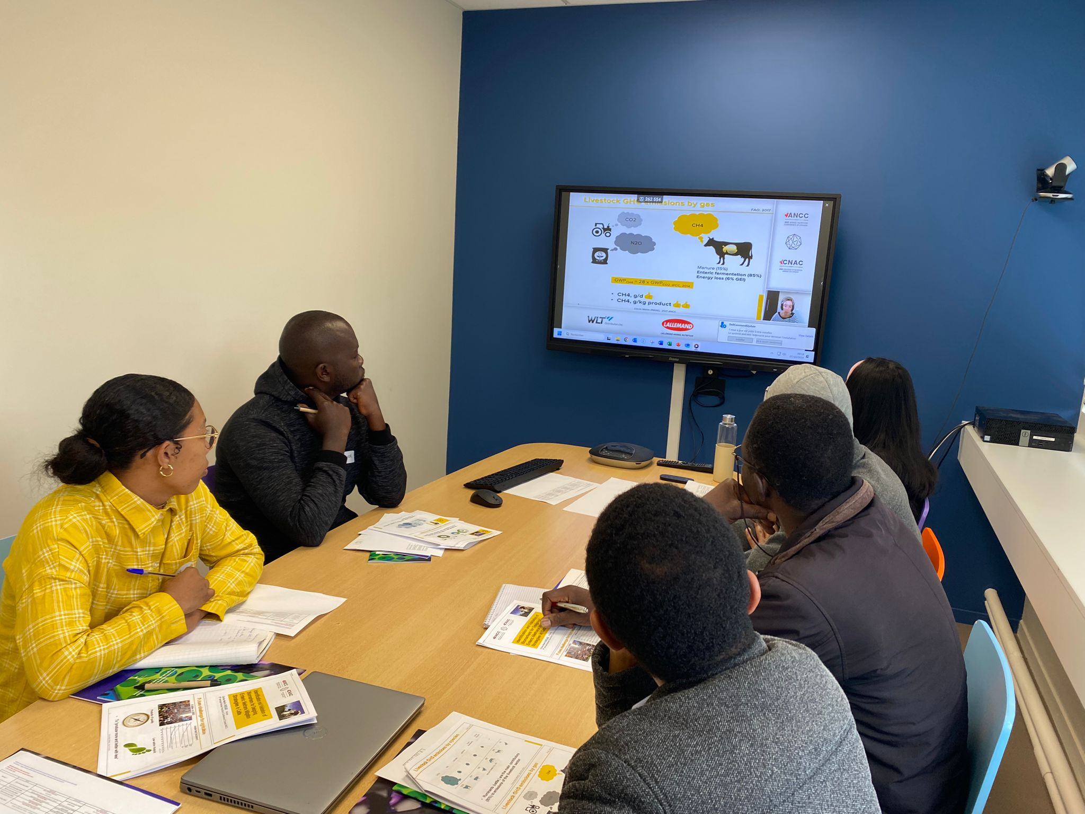
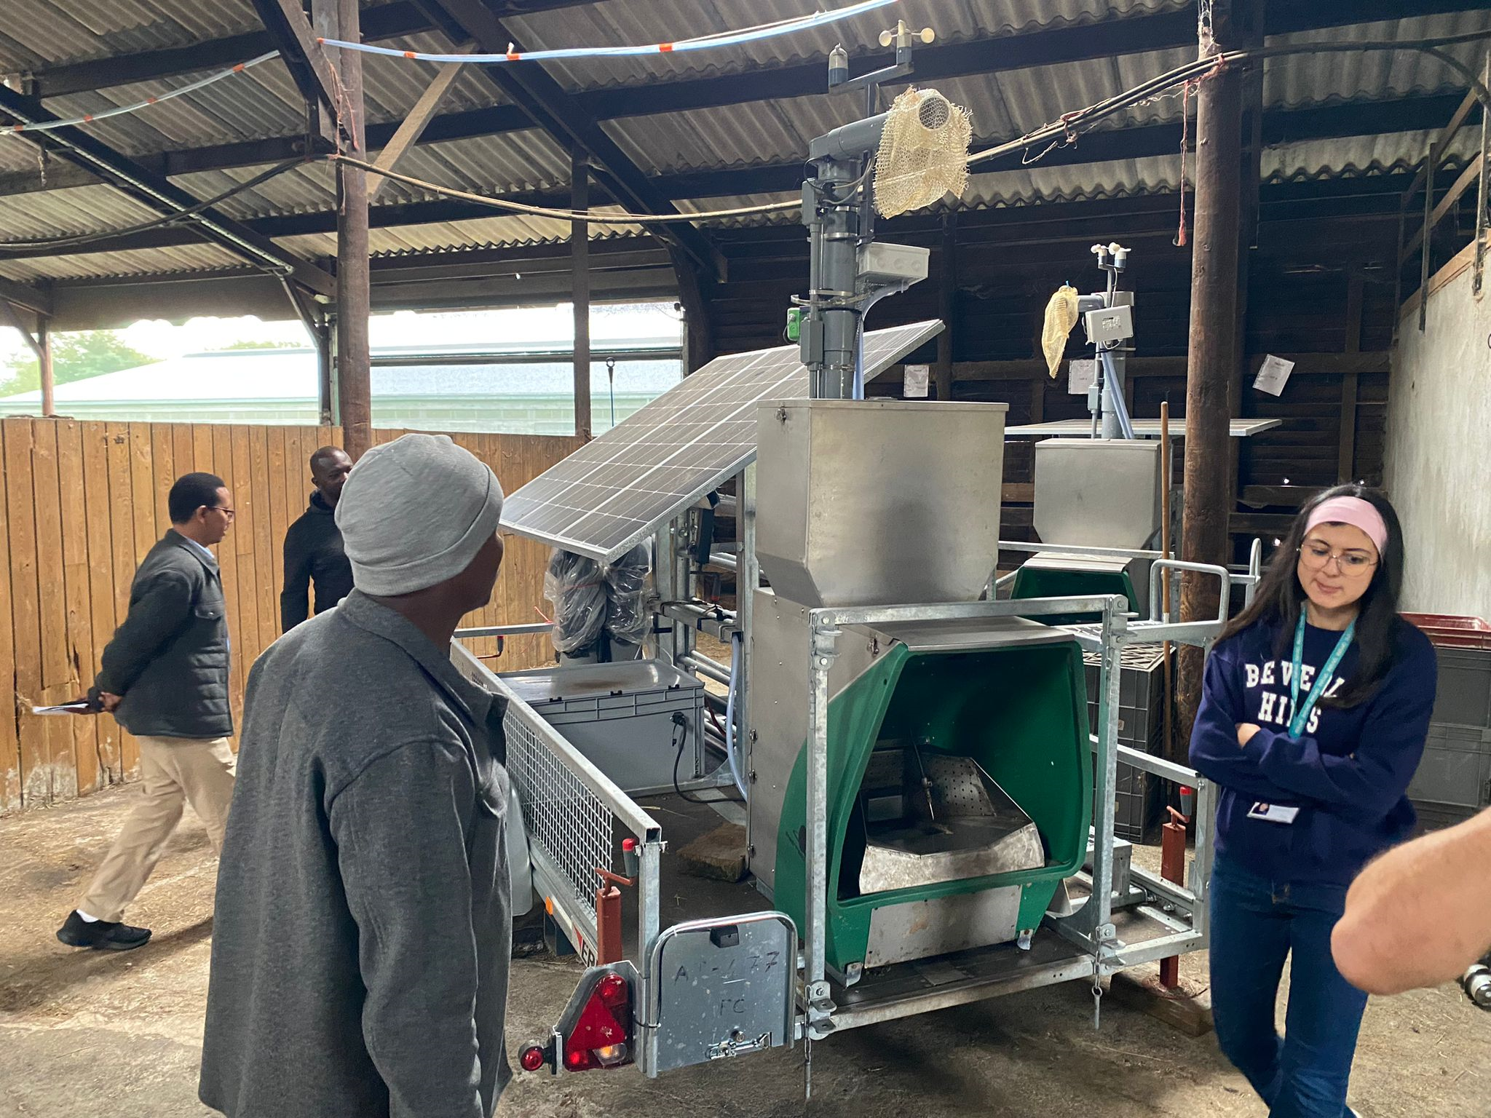
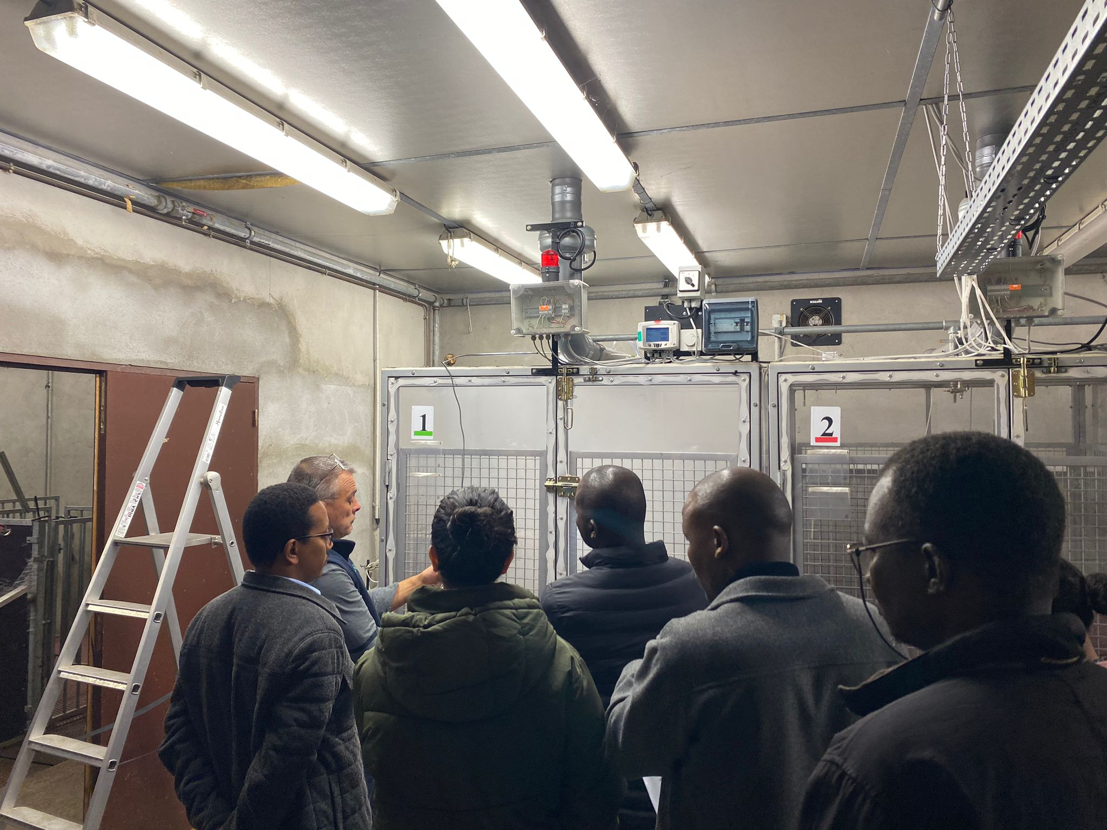
Results and Discussion (3/4)
Slides from capacaity building MeCLAN-MIPCLAN training 7-11th October, 2024
Four technicians were trained on RC, SF₆ and the GreenFeed system, along related laboratory procedures
2 from ILRI, Kenya; 1 from CIRDES, Burkina-Faso, 1 from South Africa
Notes:
Both on pasture, manure and in barn measurement.
More pictures to be added pictures to be added

Slide 9
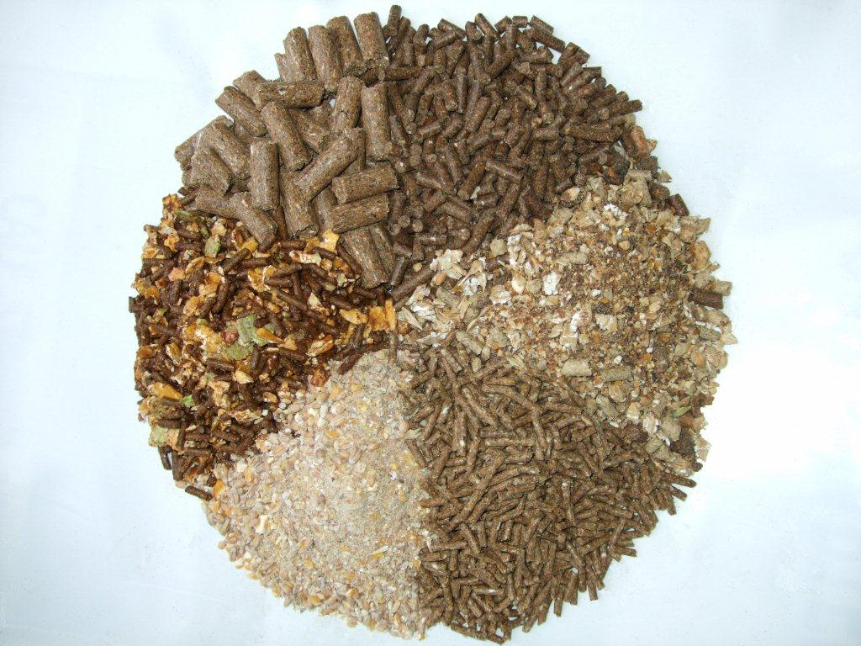
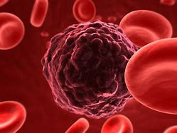
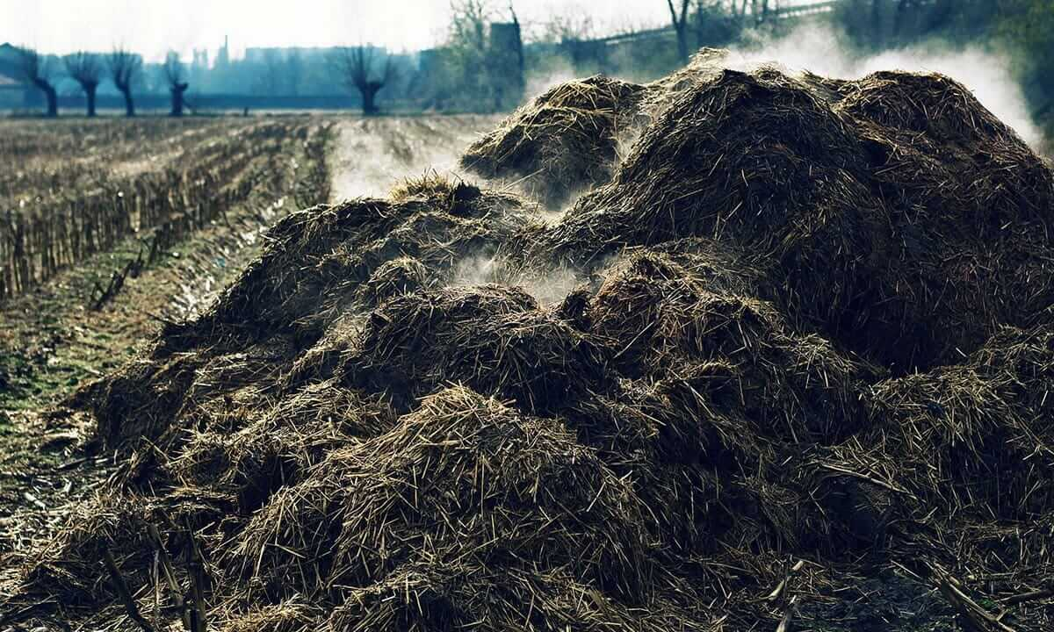
Results and Discussion (4/4)
Research gaps in GHG quantification from livestock in SSA
1. Limited context-specific emission factors
2. Limited comprehensive data on livestock management/ direct CH₄ quantification
3. Inadequate research on enteric methane mitigation strategies and ruminant microbiota
Best management practices (BMP) used to increase livestock productivity in SSA
Genetic Selection and Breeding
Animal Health and Disease Control
Record keeping and Data management
Improved Nutrition / Feeding strategies
Manure management
Notes:
Improved Nutrition and Feeding Strategies; Genetic Selection and Breeding; Animal Health and Disease Control; Enhanced Reproductive Management; Sustainable Grazing and Pasture Management; Water Management; Housing and Environmental Control; Record Keeping and Data Management; Manure Management

Slide 10
Conclusions
There are identified research gaps in GHG quantification from livestock in SSA
Academic & Research institutions, Farmers, Governments, NGOs, the private sector & International Organisations are key actors in research and development on GHG assessment within SSA
Technical deficits were identified and addressed through capacity-building training for technicians in partner institutions
Prospects
Continuous technical support for partners
Database creation & data analysis
Knowledge sharing & collaboration
Project development & sustainability
Notes:
Pillot project to be monitored next year in Benin, Nigeria and in Kenya (possible).

Slide 11
Thank you !!!
Acknowledgement
MeCLAN (2023/2024); mipclan (2024/2025)
Funded by: TSARA Initiatives
Corresponding Author: maguy.eugene@inrae.fr
Site de Theix Centre,
INRAE, France
Notes:
Transforming Food and Agricultural Systems through Research in Partnership with Africa

